Slide 1




Social Media Monitoring / Listening
What the consumers saying about our
Brands?
Products ?
Services?

Slide 2
Outline
Why Social Media Monitoring / Listening
Fields in Social Media Monitoring/ Listening
Tools for Social Media Monitoring/ Listening
Demo 1: Web Scraping → Word Cloud
What is Sentiment Analysis
Demo 2: Twitter (keyword: #LeBron, #LBJ, #LeBronJames)

Slide 3
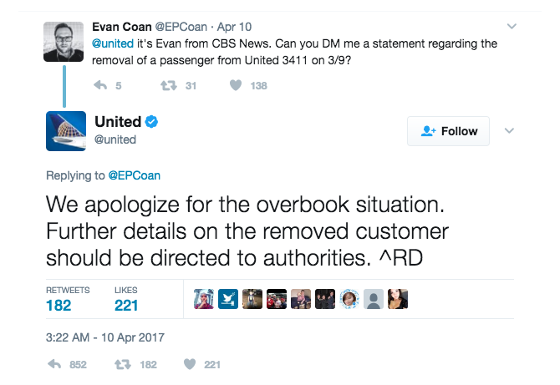
Increasing number of brands conduct Social Media Monitoring
Benefits
Better customer engagement – Consumers support brands that interact with them
Tweak your strategy real time
United Airline aggravated the situation with automated response on Twitter
Notes:
https://medium.com/digital-vault/how-united-airlines-could-have-avoided-the-crisis-on-social-media-ed63d0c47fd3

Slide 4
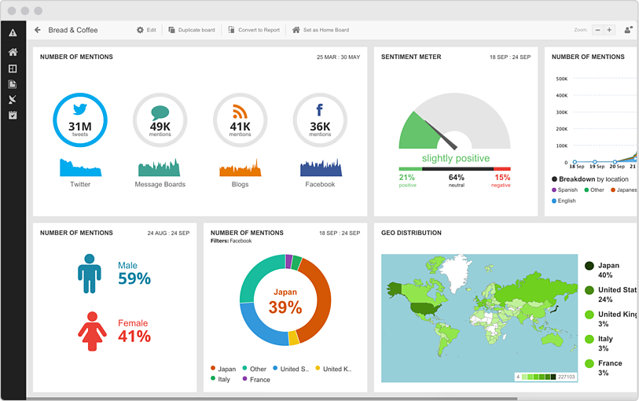
Fields in Social Media Monitoring / Listening
Social Monitoring (KPI)
Social Listening (Context / Analysis)
Track volume on Social Media
Track % of Positive / Neutral / Negative mentions
Keywords / Phrases most frequently appear
In what context is our brand mentioned?
Why an increase in positive sentiment?
Source : Hootsuite Insight

Slide 5
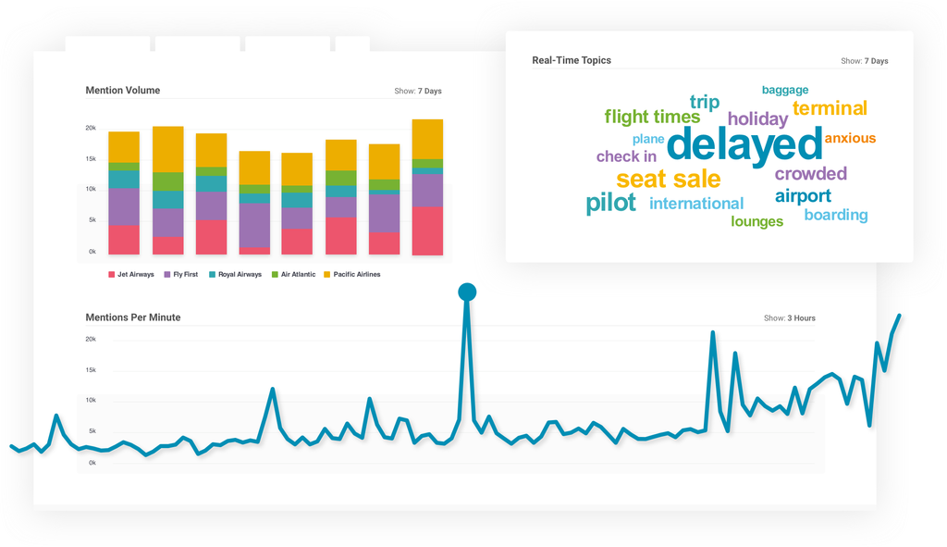
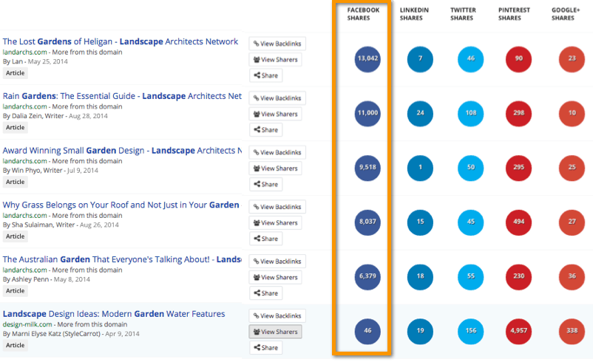
Tools for Social Media Monitoring / Listening
Third Party Tools
(SaaS)
Open Source Tools
(Packages)
Hootsuite Insight
Brandwatch
ReviewTrackers
BuzzSumo
R
SentimentR
Tidytext (dictionary based)
RTextTools()
Python
Textblob
spaCy
Google Cloud Client Library for Python
Source : Brandwatch
Source : BuzzSumo

Slide 6
Demo #1
Please open “Social_Analysis_Sample1.py” or Social_Analysis_Sample1.ipynb”
For this demonstration, I’ll use Jupyter Notebook but please use whatever editor/IDE comfortable for you
In this Demo, we’ll extract comments on Instant Cash Offer from a Redflagdeals forum and create a wordcloud to see which keyword appears the most

Slide 7
What is Sentiment Analysis
Sentiment Analysis (also known as Opinion Mining) systematically identify, extract, quantify, and study affective states and subjective information (Wikipedia)
Subfield of Natural Language Processing (NLP). NLP is a subfield of Artificial Intelligence, replicating human’s own interpretation of everyday language

Slide 8
Demo #2
In this Demo, we’ll use Tweepy to extract all the tweets that contain #CIAS2019 (Auto Show 2019) within Canada, clean up data, and conduct sentiment analysis using Textblob (python package)
Textblob has keywords and their associations to a certain sentiment (positive/neutral/negative)
We can check the accuracy of the analysis!
Computer isn’t smart enough to read between the lines (e.g. “LeBron James was on fire last night, killed Raptors) may be considered negative due to use of vicious language

